Slide 1

Required Dealership Record Retention
Guidelines & Best Practices
Thursday, April 30, 2026

Slide 2

Sales Tax Seminar
Center for Automotive Education & Training
Tuesday, May 12, 2026:
9:30 AM – 12:00 PM
Learn How to Handle Sales Tax
Sales tax issues can be complicated and confusing and may lead to costly errors. This seminar will cover the most common sales tax questions received by GNYADA.
Visit www.gnyada.com/events to register

Slide 3

Management of Document Scanning , Dealership Record Retention Guidelines,
Compliance & Best Practices

Slide 4
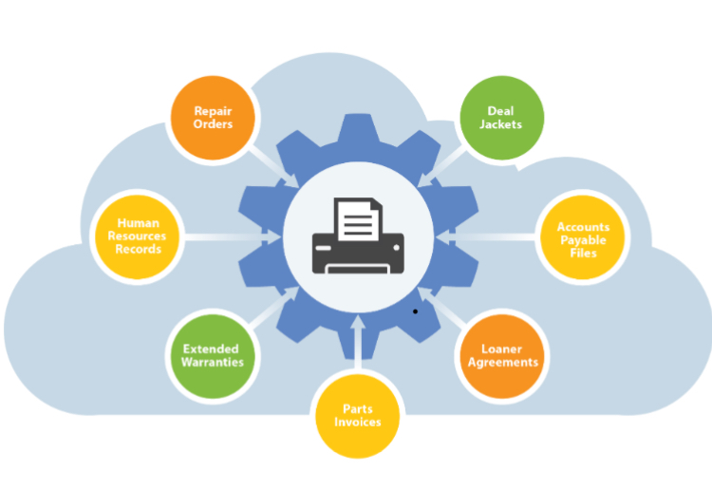

Dealership Documents Scanned,
Verified & Encrypted at Rest…

Slide 5
Suggested Document Retention Requirements
Accounts Payable 7 Years
Accounts Receivable 7 Years
Human Resources 6+ Years
Deal Jackets 10 Years
Repair Orders 2 Years plus length of warranty
OEM retention requirements may exceed.
Retention periods listed are a minimum suggested periods. Please check with your Legal Counsel or Accounting Professional.

Slide 6
OEM, FTC and other Agencies
Requirements & Document Retention
Encrypt & Protect Customer Information
Encrypted at Rest
Securely store customer information with SOC1-SOC2 vendor
Digitally control & limit access to customer info
Verify all scanned paper against an electronic file.
Adhere to Agency Document Retention Requirements
  i.e. HR Records 6 years+
  Deal Jackets 10 years
  A/R & A/P 7 years

Slide 7
Paper File Room
Fundamental Procedures
Secured File Area for recent & historical paper files.
Controlled access for retrieval & re-filing of paper requests.
Audit Trail of retrievals by user (view log report)
Misfiling of documents. (50% of documents are lost or misfiled)

Slide 8
Achieving 100% Verification of Records Scanned
API Service, Sales & other records files from DMS
Paper scanned internally by dealership labor and/or via outsource service bureau labor off site independent of & integrated with DMS
100% Verification that all Deals, Repair Orders & other records created have been captured for permanent retention.
Exception Reports detailing any Deals, Repair Orders & other records that have not been scanned.

Slide 9
Best Practices & Savings Tips
Paper Documents Must be Scanned for FTC Required Encryption at Rest with NPI (non-public info)
Protect clients’ personal information.
Securely store customer information
Limit risk of customer info theft
Avoid potential penalties & FTC fines (up to 100k per violation)
Meet compliance requirements of Amended Safeguards & CARS Rule
Documents readily available for OEM & other audits
Reclaim retail space
Save labor costs associated with filing and retrieving documents
Eliminate loss and misfiling of documents
Limit access to documentation.

Slide 10
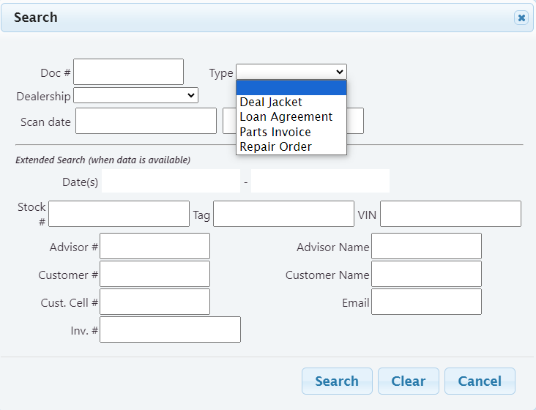
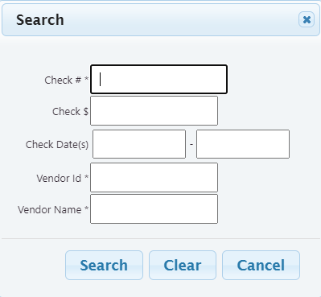
Find Documents by Multiple Fields

Slide 11
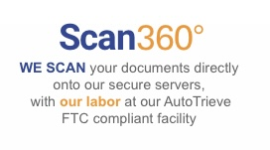

Document Conversion Options
DMS
Independent & Integrated
Document Scanning

Slide 12


