Slide 1




GNYADA Webinar
The New Standard of Service: Transparency, Trust, and Retention
Notes:
Rob

Slide 2
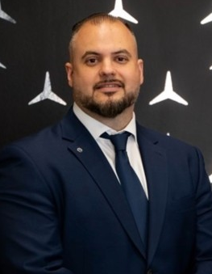

Featured Industry Panelists
A GNYADA Member Collaboration: UVeye is proud to be a new member of the Greater New York Automobile Dealers Association, joining GNYADA member Silver Star Motors - who actively utilizes UVeye's automated drive-through inspection systems in their Long Island City facility.
Gus Karagianis
Rob Hubbell
Service Director
Silver Star Motors
VP of Enterprise Sales
UVeye
Notes:
Both

Slide 3
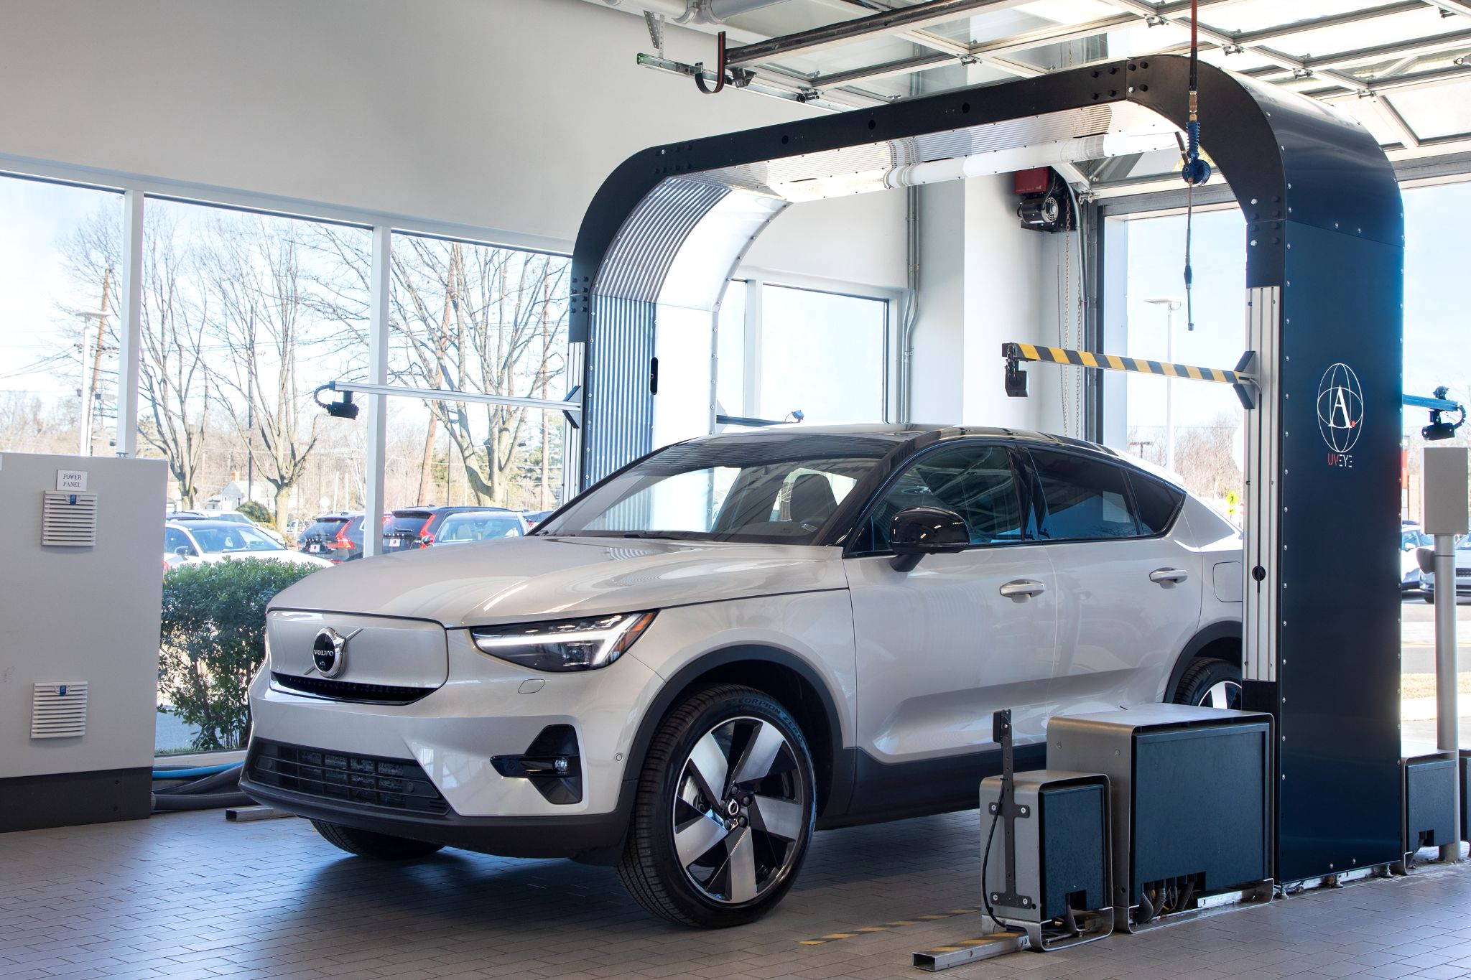
Automated Full Vehicle Inspection
Undercarriage Inspection: Inspection of the undercarriage to identify difficult to notice anomalies and damages.
360º Inspection: Inspection of all external attributes of a vehicle, including tiny scratches or dents.
Wheels & Tires Inspection: Inspection of tire physical attributes to assess the risk level, need for alignment and/or replacement.
Interior Inspection: 360º camera, OBD-II diagnostics and engine audio recording to detect hidden issues and ensure a fully automated evaluation.
UVcamp: All scans are stored on our cloud-based platform that can be accessed anywhere at anytime from any device
Notes:
Rob

Slide 4
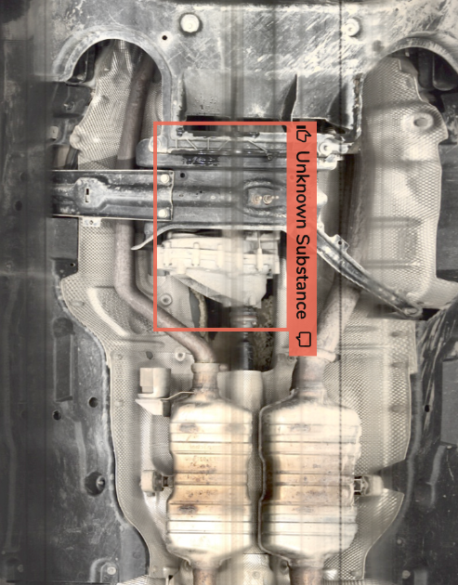
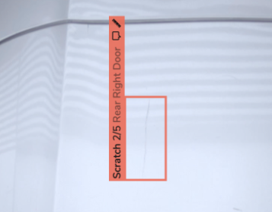
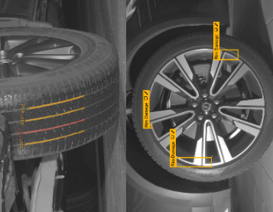
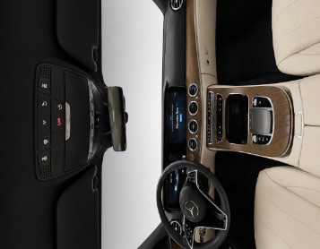
UVeye Detections
Undercarriage Inspection
Exterior Inspection
Wheels & Tires Inspection
Interior Inspection
Notes:
Rob

Slide 5
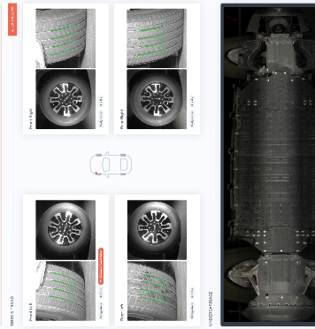
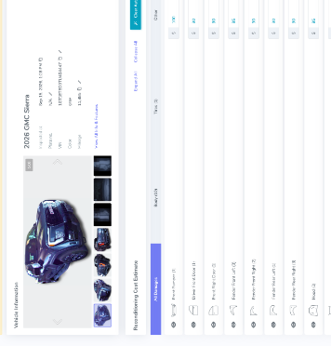
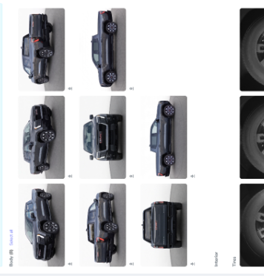
A Single Scan Will Provide
Service Inspection Report
Appraisal Recon Report
Merchandising Images
Notes:
Rob

Slide 6

Silver Star Motors Introduction
Silver Star Motors is an authorized Mercedes-Benz passenger vehicle and commercial Sprinter van dealership located at 36-11 Northern Boulevard in Long Island City, Queens, New York.
Operating since 1952, this family-owned and operated dealership provides a large selection of new, pre-owned, and certified pre-owned Mercedes-Benz vehicles alongside a certified service and parts department.
Notes:
Gus

Slide 7
How Silver Star Motors Incorporated UVeye
STAGE 1 • 100% DRIVE SCAN
STAGE 2 • TABLET REVIEW
Lane Ingestion
The “Vehicle MRI”
Every guest drives through the automated archway upon arrival. Tires, underbody, and exterior are scanned in 3 seconds before parking.
Advisors greet the client with a tablet showing hi-res photos tagged with their license plate. The conversation starts from collaborative health.
STAGE 3 • RIM METHOD
STAGE 4 • RETENTION CLOSING
Triaged Review
Instant Quotes
Findings are categorized into Required safety, Immediate wear, and Maintenance items, giving the customer complete agency over repairs.
Advisors quote OEM tires on the spot with road-hazard warranties. Inspection records trigger timely automated 12–13-month follow-ups.
Notes:
Gus

Slide 8



The Evolution of Customer Trust
Visual Confirmation
Consumer faith in verbal claims has evaporated. Today's automotive clients demand indisputable photographic proof to substantiate every recommendation.
Instant Communication
Every guest drives through the automated archway upon arrival. Tires, underbody, and exterior are scanned in 3 seconds before parking.
Removing Mystery
Service lane anxiety stems from unexpected repair expenses. Unveiling scan findings upfront eliminates repair sticker shock before work orders begin.
Notes:
Gus

Slide 9



Building Trust Through Transparency
Objective
Transparency
Earned
Customer Trust
Predictable
Retention
Drive-through scans capture high-resolution imagery of tires, exterior, and undercarriage with the vehicle's license plate before wheels touch a lift.
Positioned as an objective "Vehicle MRI." Advisors review condition reports side-by-side on tablets, eliminating bill shock and transforming skepticism into collaboration.
Transparent diagnostics and instant tire quoting protect the high-risk 12–13-month defection window, securing repeat maintenance visits for the life of the vehicle.
The Retention Flywheel: Transparency eliminates consumer doubt → earned trust drives repair approvals → consistent transparent experiences lock in long-term customer retention.
Notes:
Both

Slide 10



Advisor Framework: The RIM Method
How Silver Star Motors presents service recommendations:
R = Required
I - Immediate
M - Maintenance
Critical safety repairs that demand immediate action. If declined, customers sign an acknowledgement, reinforcing urgency without artificial pressure.
Developing wear or budding concerns that will soon compromise performance. Customers are briefed early so upcoming maintenance never comes as a surprise.
Recommended preventative services. Customers understand it can be completed today for convenience or planned for their next routine service visit.
The result: higher approval rates without high-pressure selling.
Notes:
Gus

Slide 11
Proven Results: Tires and Alignments
+35%
+12%
Tire Sales Volume
Wheel Alignments
Achieved in Silver Star's first full month of automated drive-through scanning compared to previous year.
Full-surface tire groove mapping catches early inner/outer rib wear, unlocking immediate alignment opportunities.
Notes:
Gus

Slide 12
Proven Results: Customer Retention
143%
At Silver Star Motors, we define a retained client as recurring business within 12 to 13 months. By coupling high-tech inspection scans with VIP amenities - warm welcomes, loaners, and rideshare options - we eliminate friction.
As long as the client is fully informed and sees the truth upfront, they are satisfied. Satisfaction isn't driven by low prices - it's driven by absolute transparency.
Service Loyalty Index
Retention is Built on Consistent Experience Mercedes-Benz Service Loyalty Performance Benchmark
Notes:
Gus

Slide 13
Dealer Perspective
"Visuals take all the mystery away. When clients see the scan with their own license plate, the sales friction is gone. It becomes a collaborative conversation about keeping their vehicle safe."
Gus Karagianis
Service Director, Silver Star Motors
Notes:
Gus

Slide 14




Protecting Tire and Retention Value
Immediate Visual Tread Depth
Instant Counter Quotes
Scanners read tire tread across the entire surface, detecting alignment wear instantly at check-in.
Advisors pull immediate replacement quotes while reviewing the visual report, eliminating third-party price shopping.
The Dealership Value Add
The 13-Month Window
Pairing verified inspection data with a 1-year dealership road hazard warranty secures retention.
Proactively catching tire and brake wear ensures drivers return within the critical 12-to-18-month loyalty threshold.
Notes:
Both

Slide 15
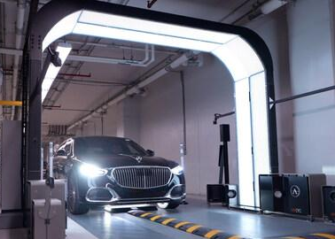
Protecting Shop and Integrity
Pre-Service vs. Post-Service Capture
Automated visual capture on both entry and exit provides an irrefutable audit trail. When customers raise questions about pre-existing damage, advisors review timestamped images together.
Objective condition reports protect technician integrity, prevent costly dispute payouts, and turn potential conflicts into long-term trust.
Notes:
Gus

Slide 16
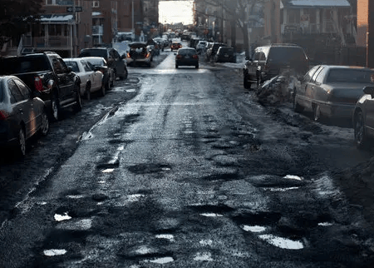
NYC Driving Realities and Wear
Metro New York Conditions: Severe potholes, tight curbs, harsh winter salt, and stop-and-go braking - inflict heavy, invisible damage on customer vehicles.
Curb Rash & Rim Bends: Scanners catch wheel lip impact and hairline rim cracks before customer liability disputes arise.
Uneven Tread & Road Hazards: Early detection of alignment pull saves high-performance tires from premature failure.
Pre/Post Service Audit: Entry/exit scans create an indisputable visual record protecting dealership technician integrity
Notes:
Both

Slide 17
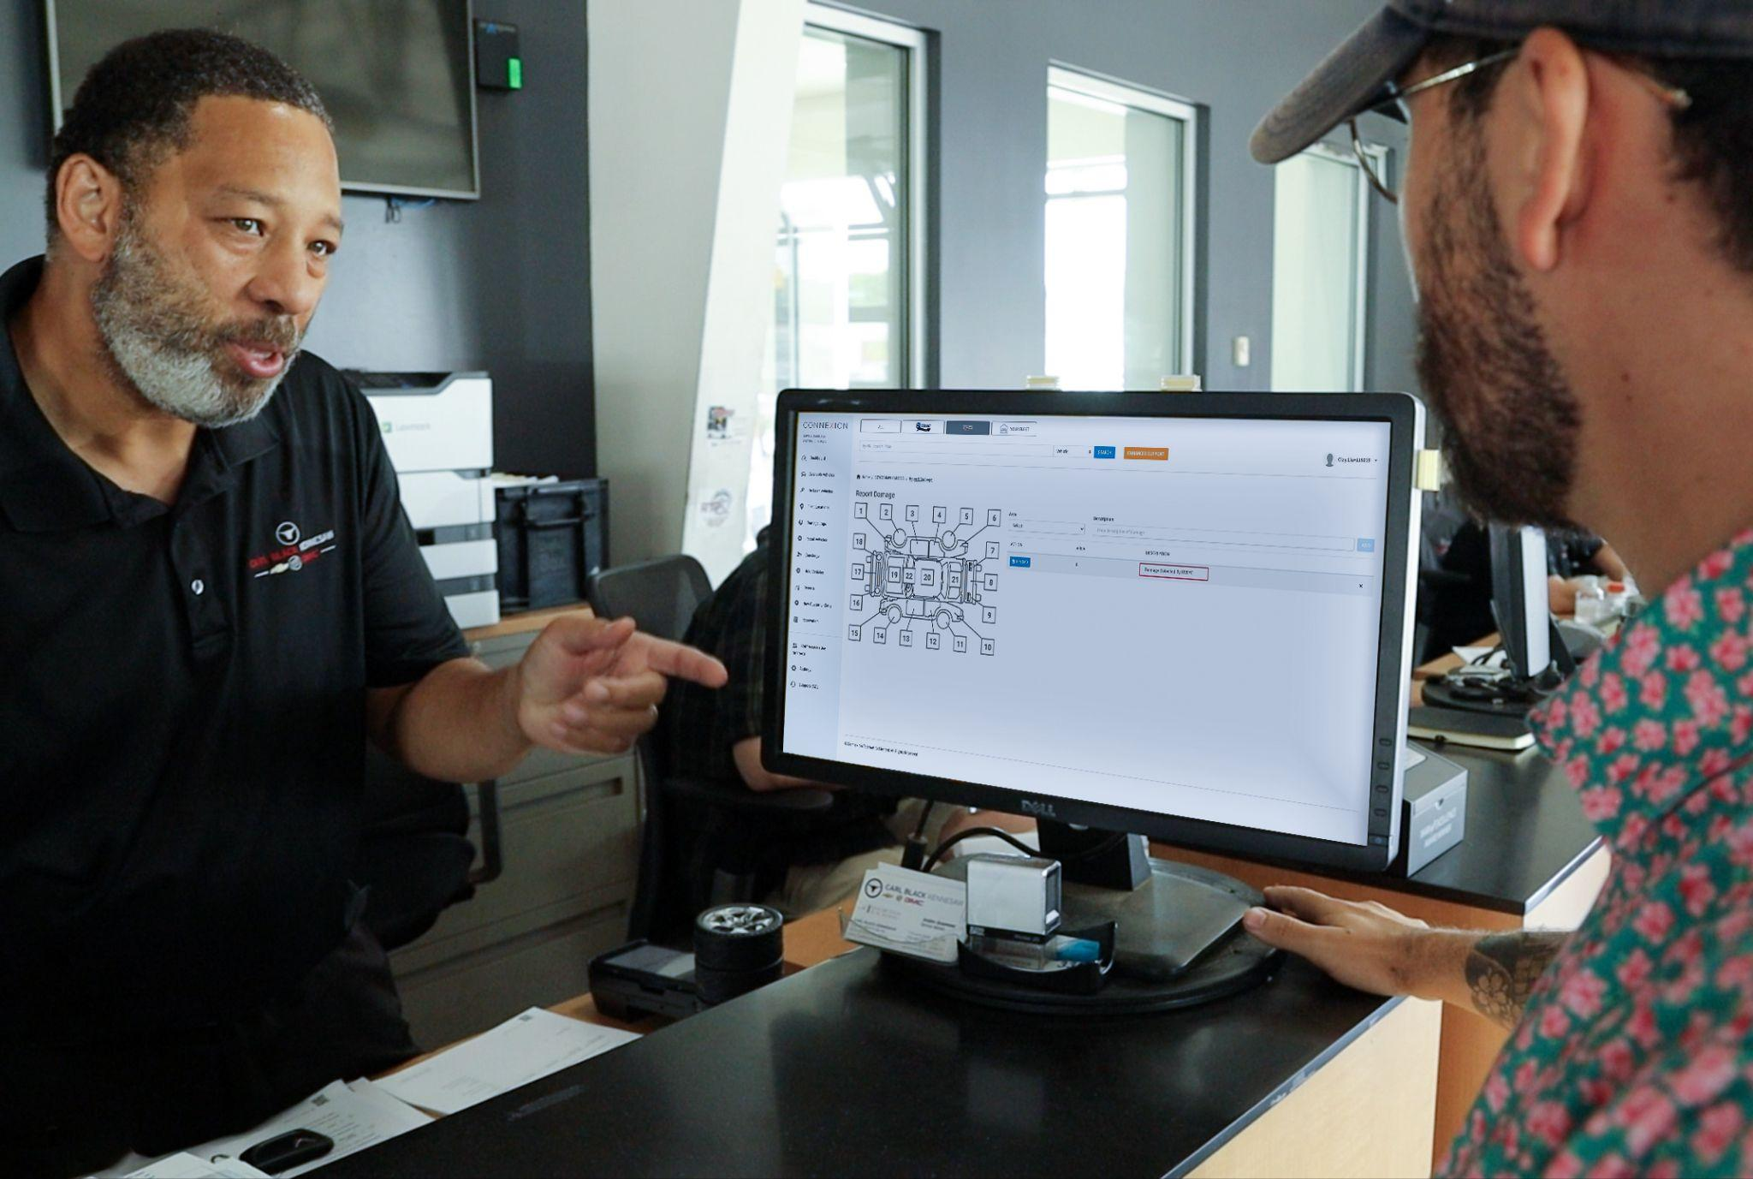
Where the Industry is Headed
Becoming Routine
Automated inspection is moving from a novelty into a routine step at check-in, as dealerships look for a faster, more consistent way to document vehicle condition.
Beyond the Service Lane
The same kind of condition data is increasingly used earlier in a vehicle’s life too, informing appraisal and acquisition decisions, not just service write-ups.
Notes:
Both

Slide 18
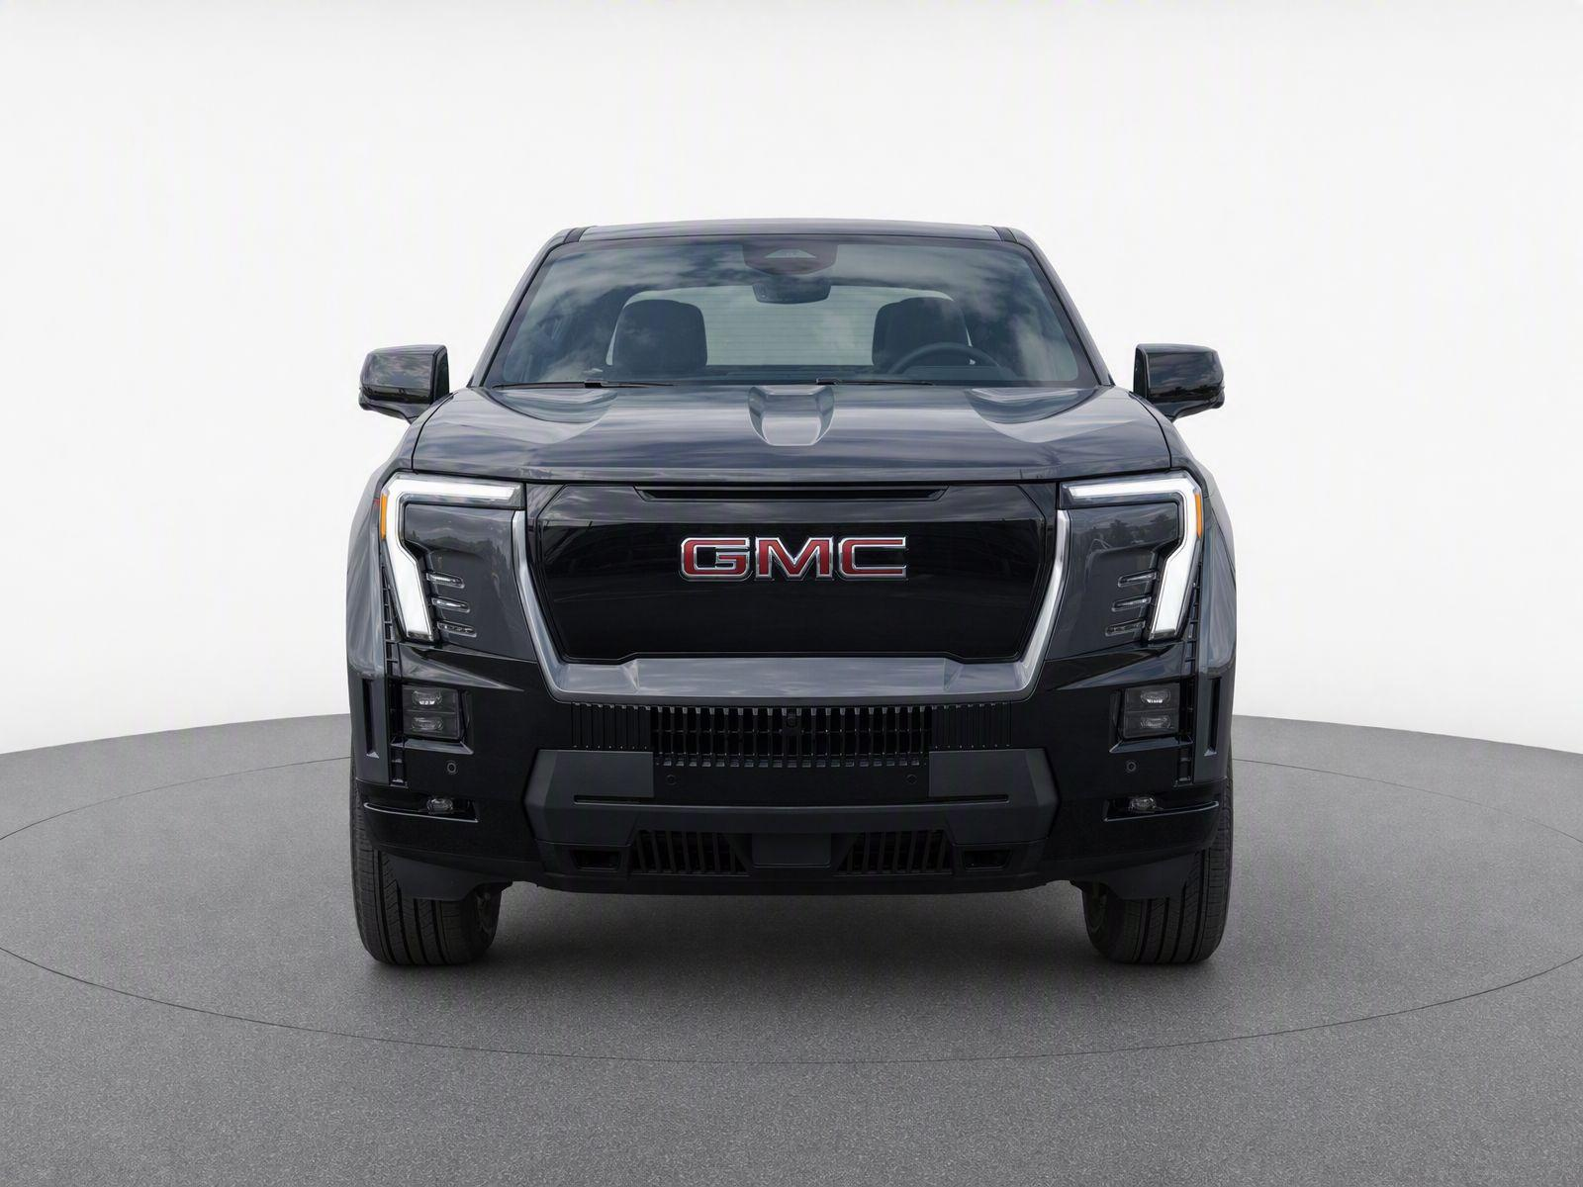
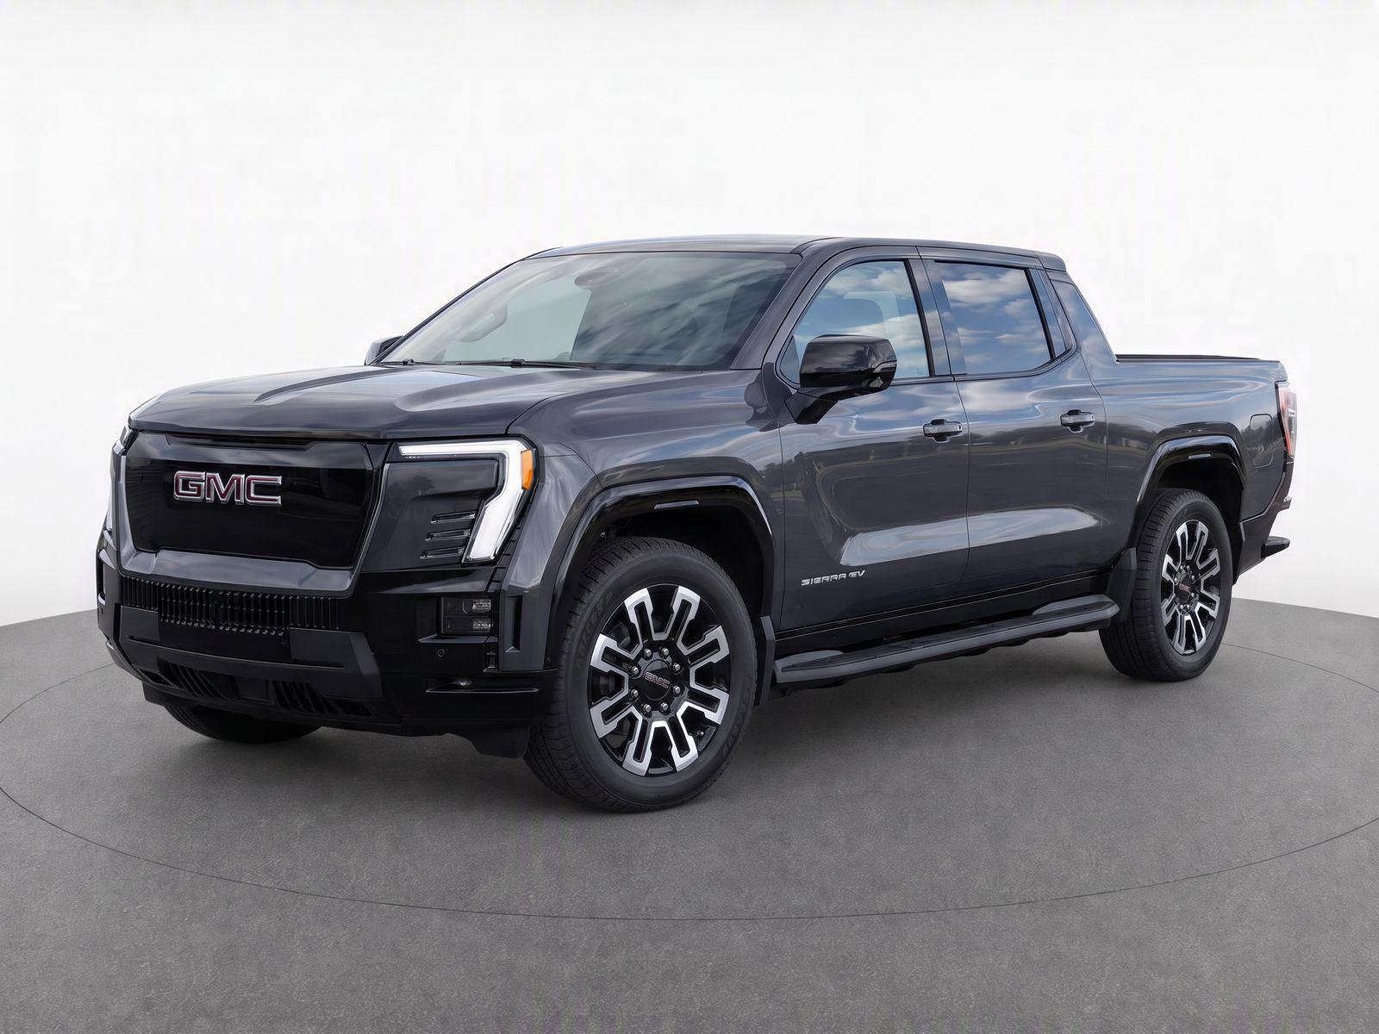
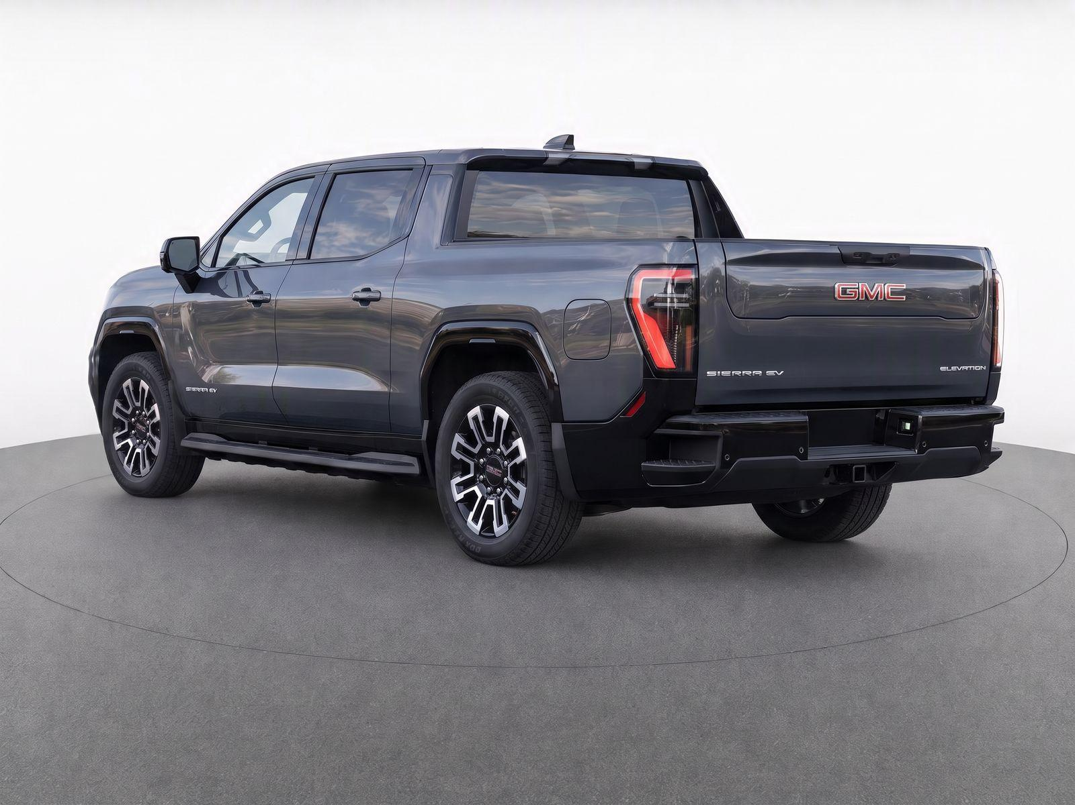
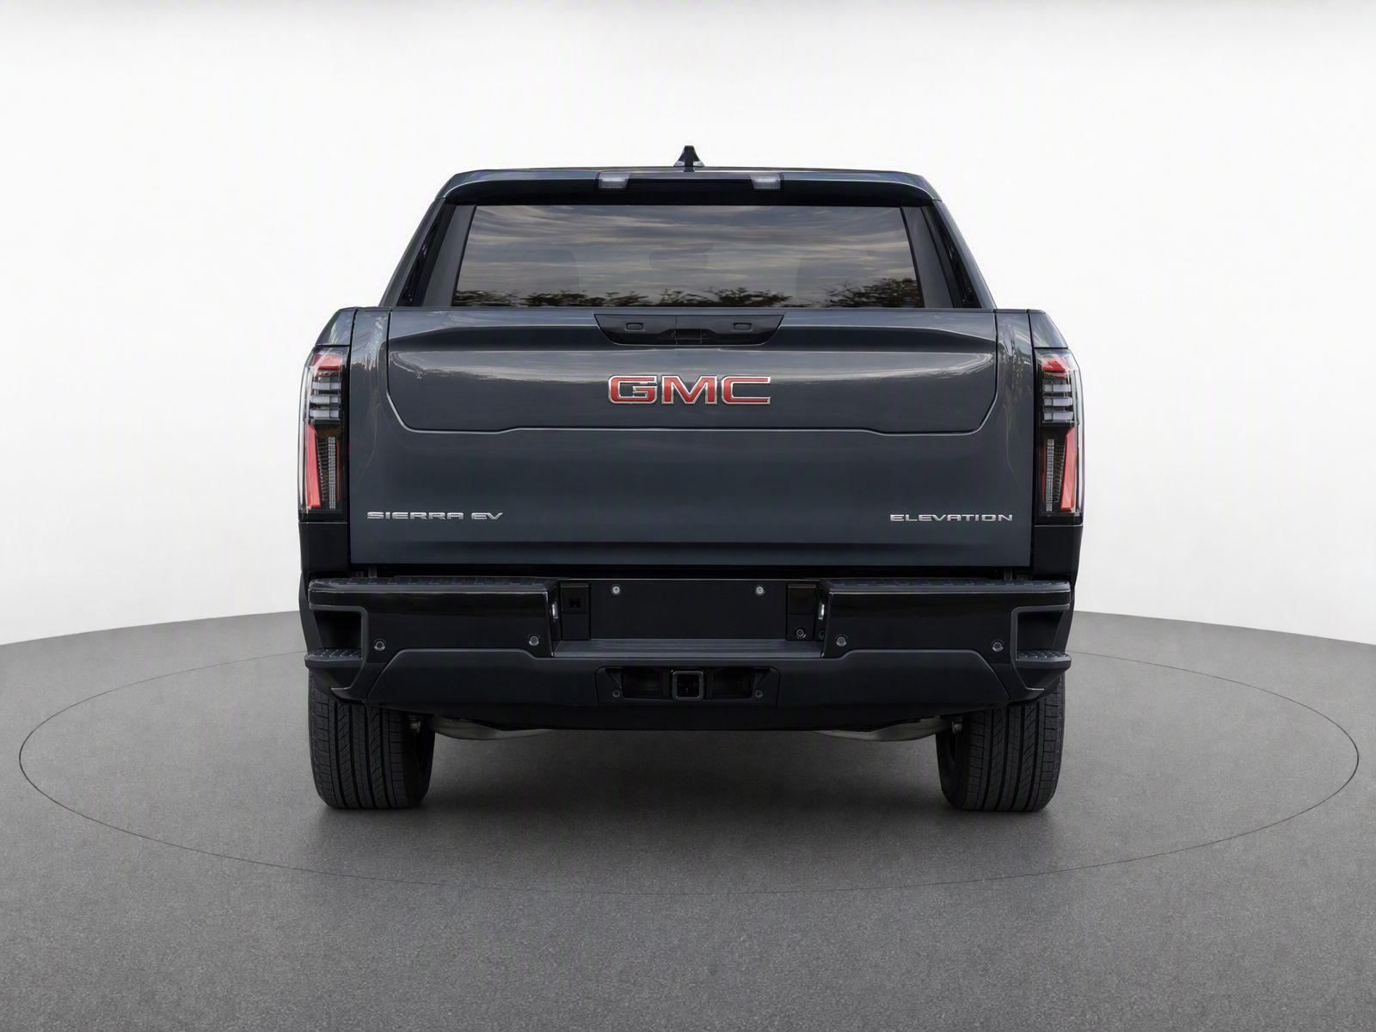
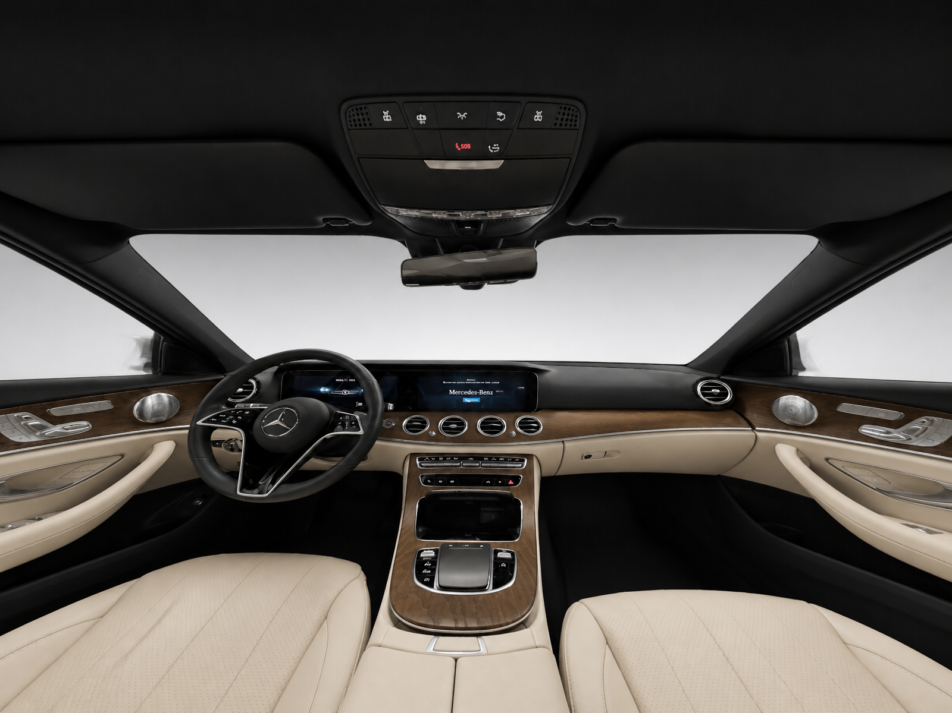
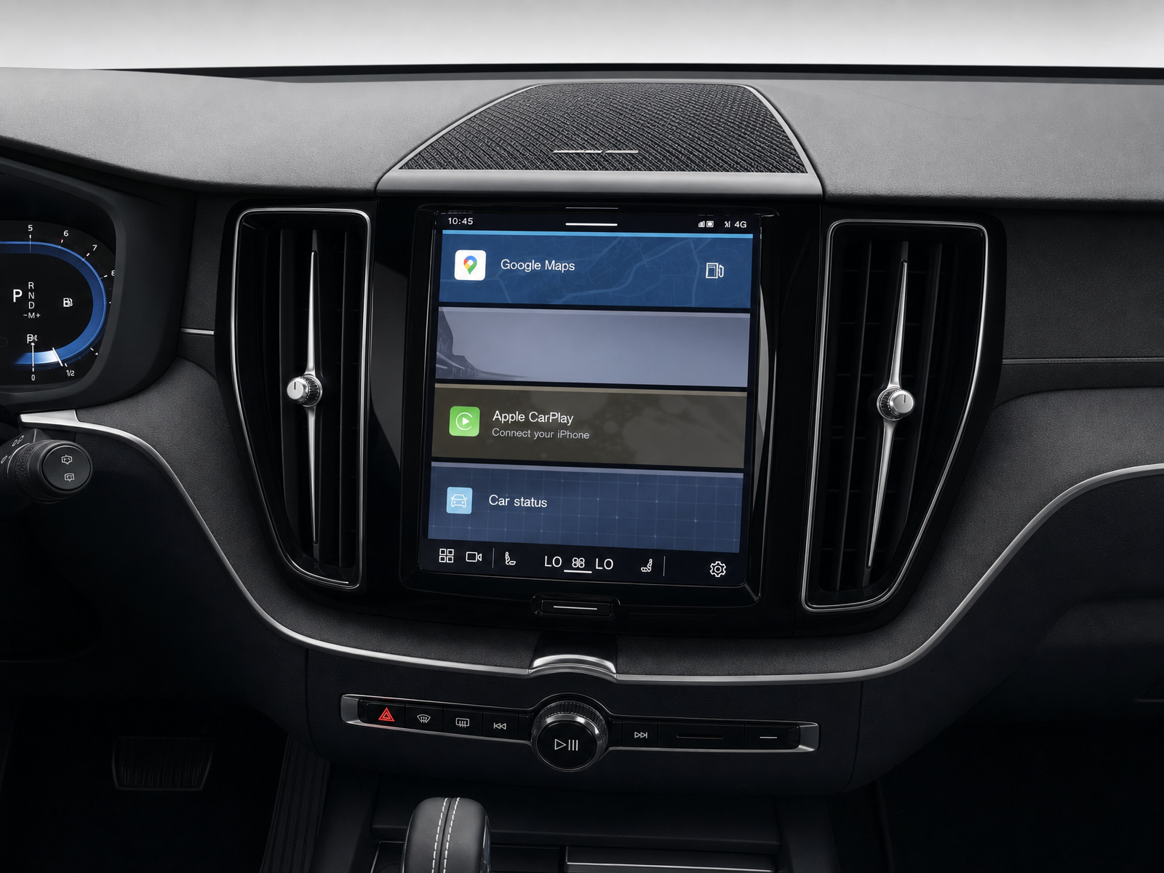


UVeye Beyond Service
Sell Every Vehicle Faster with UV360 Merchandising
Accelerate inventory photo capture:
1 vehicle scan
produces a full set of 360 images
Enable same-day vehicle listing:
7 days faster sales
for UV360 merchandised vehicles
Reduce Holding
Costs:
$85/day cost
of unlisted vehicles for dealers
Integrated with:
Notes:
Rob

Slide 19
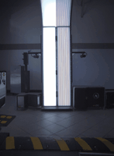
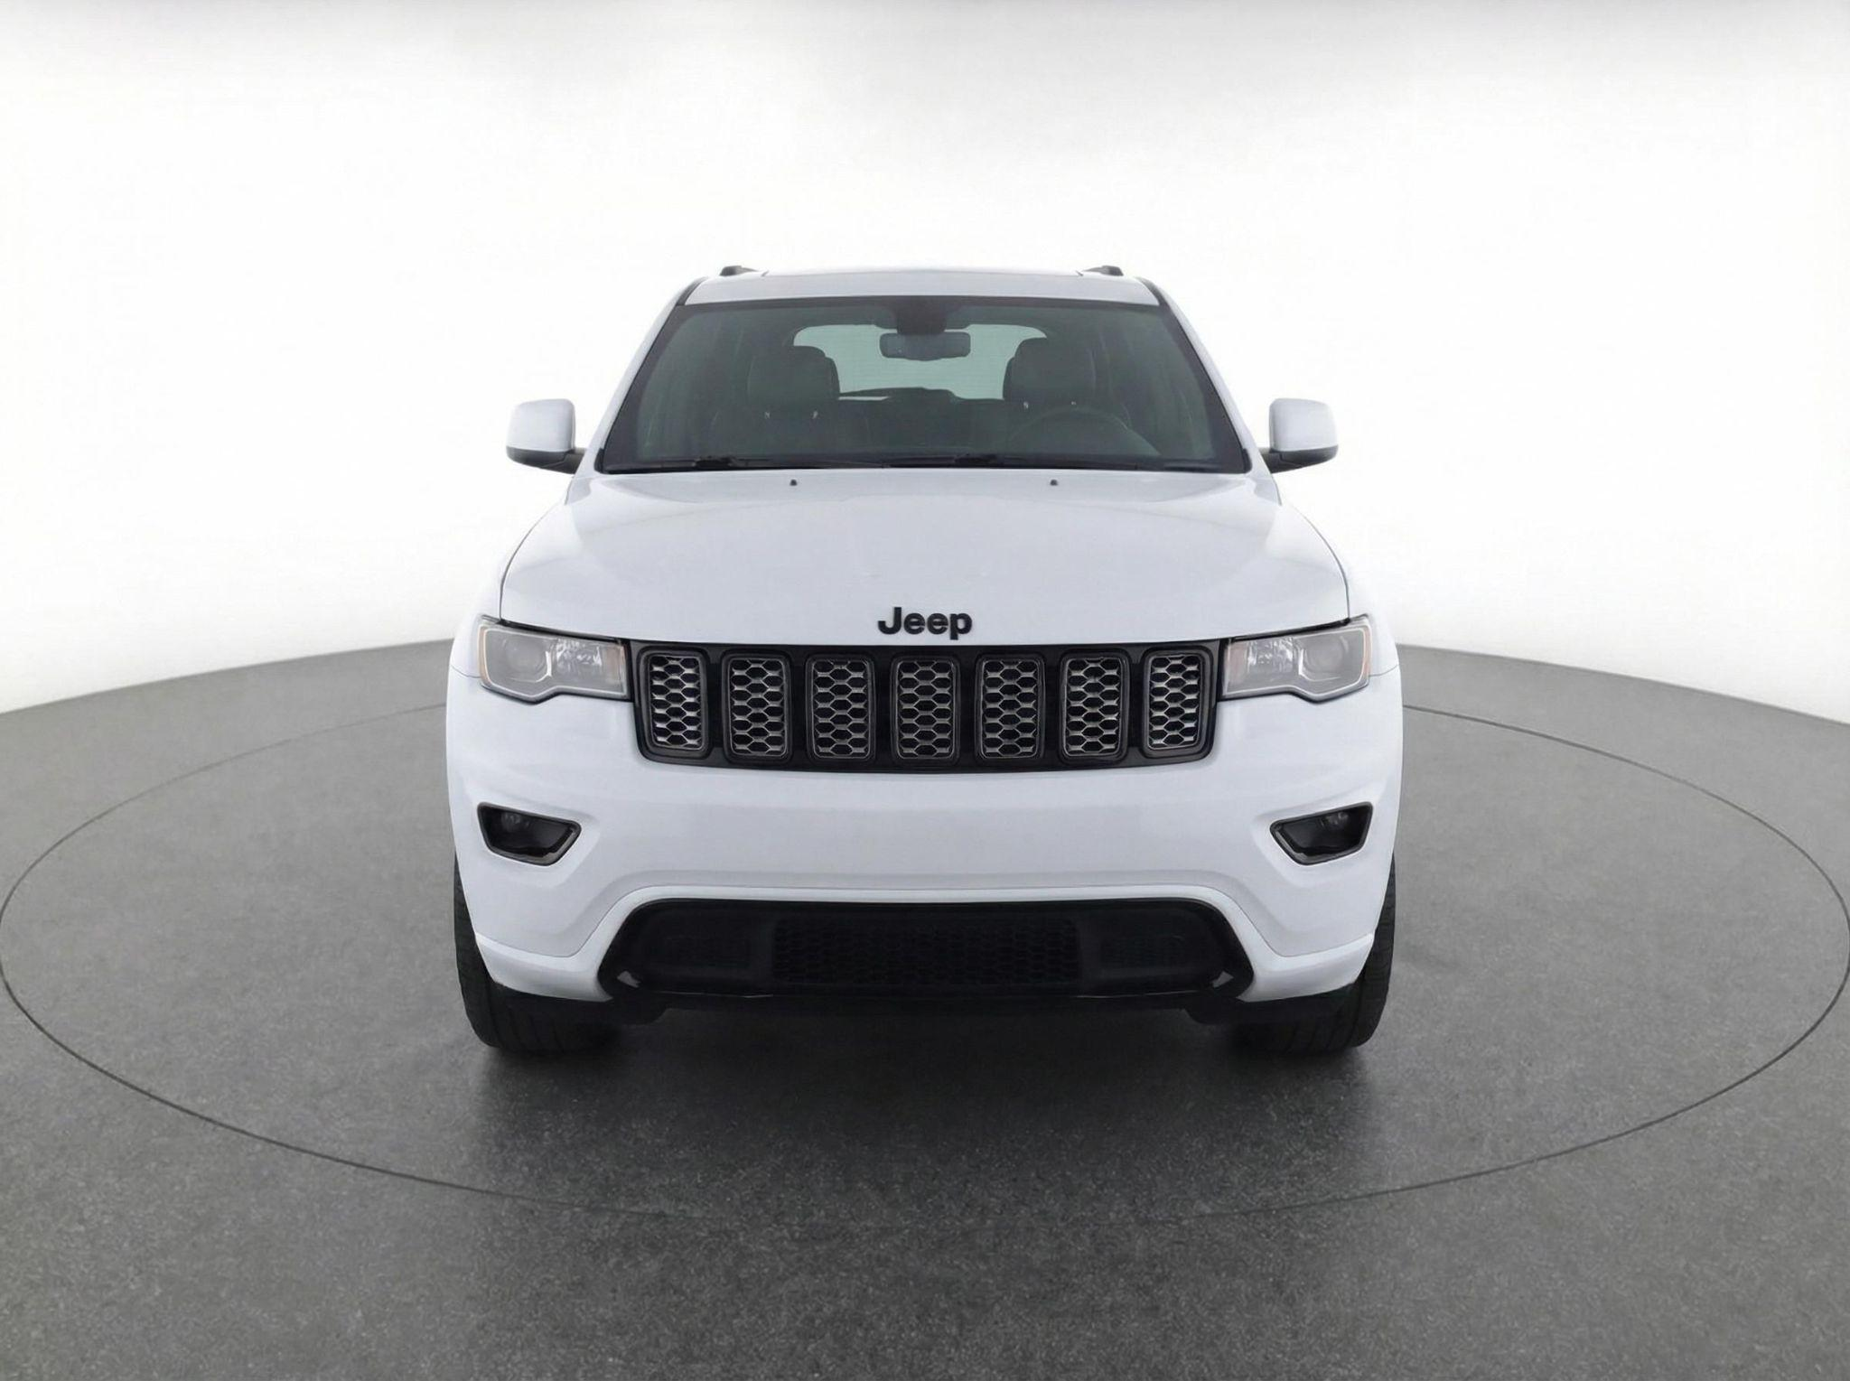
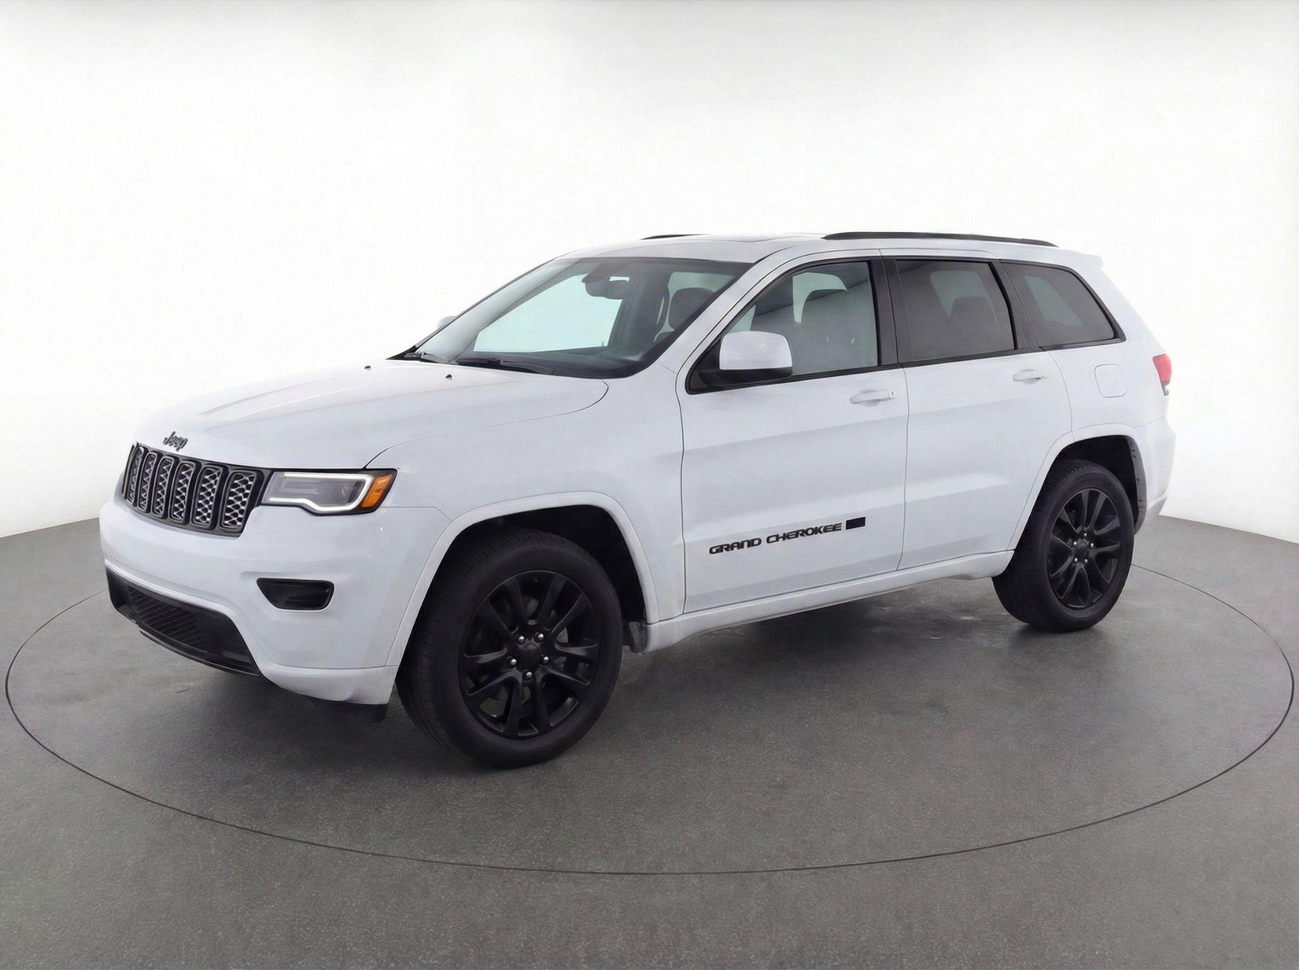
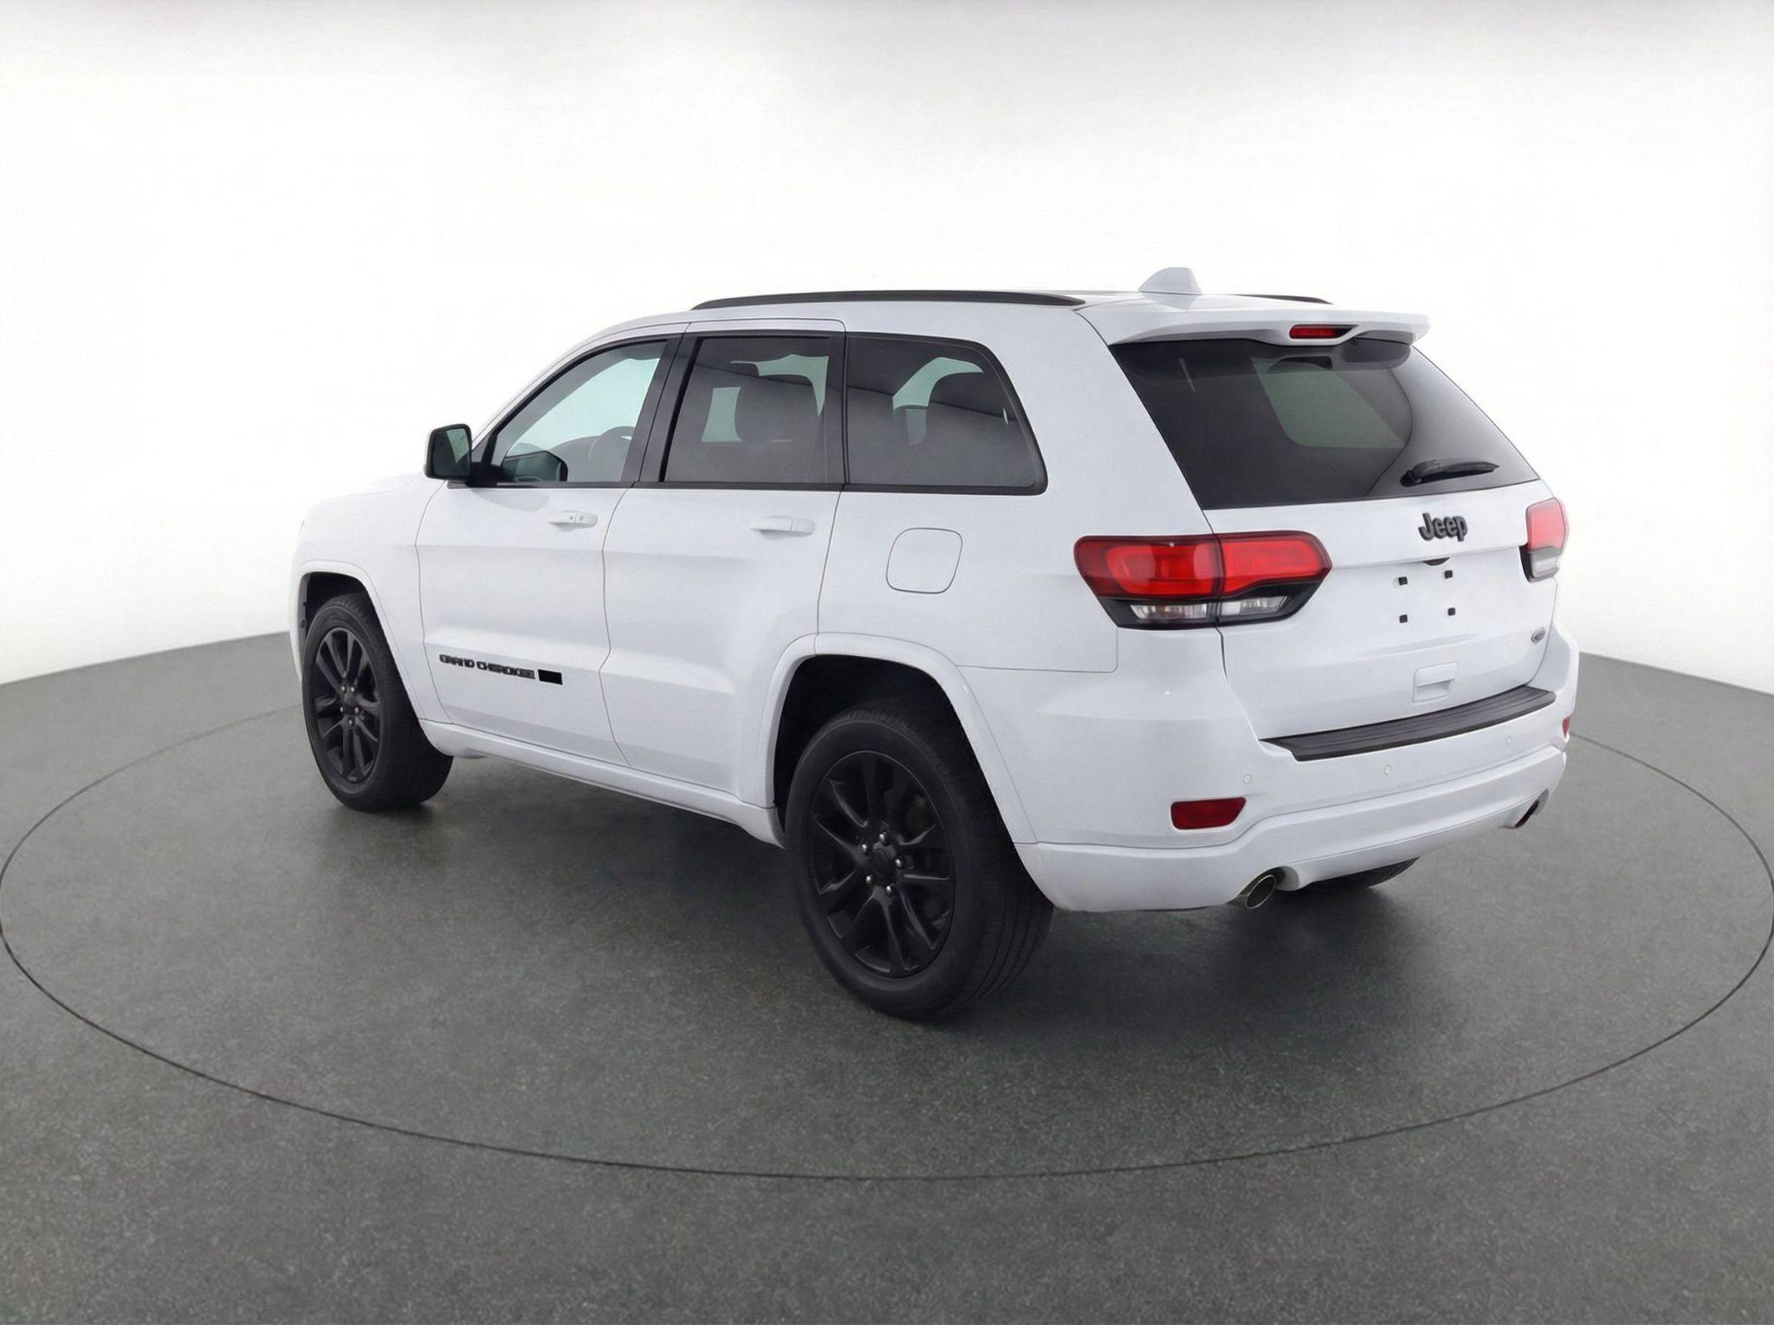
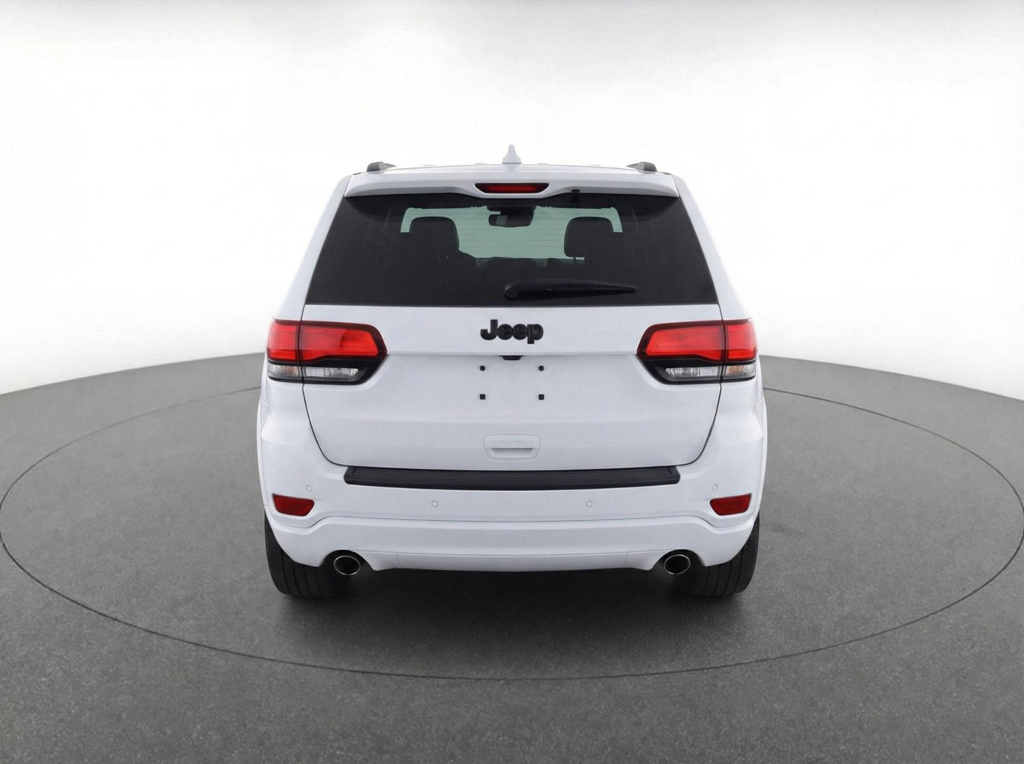
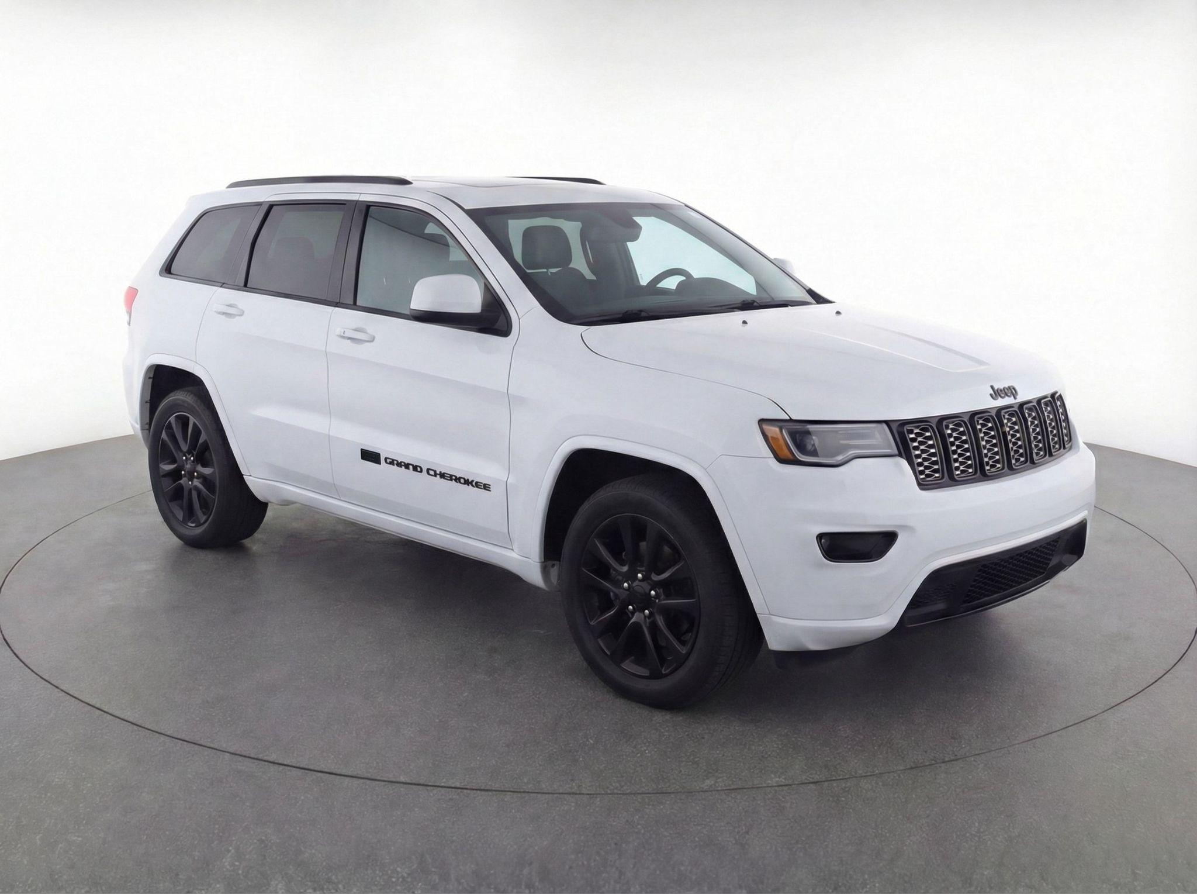
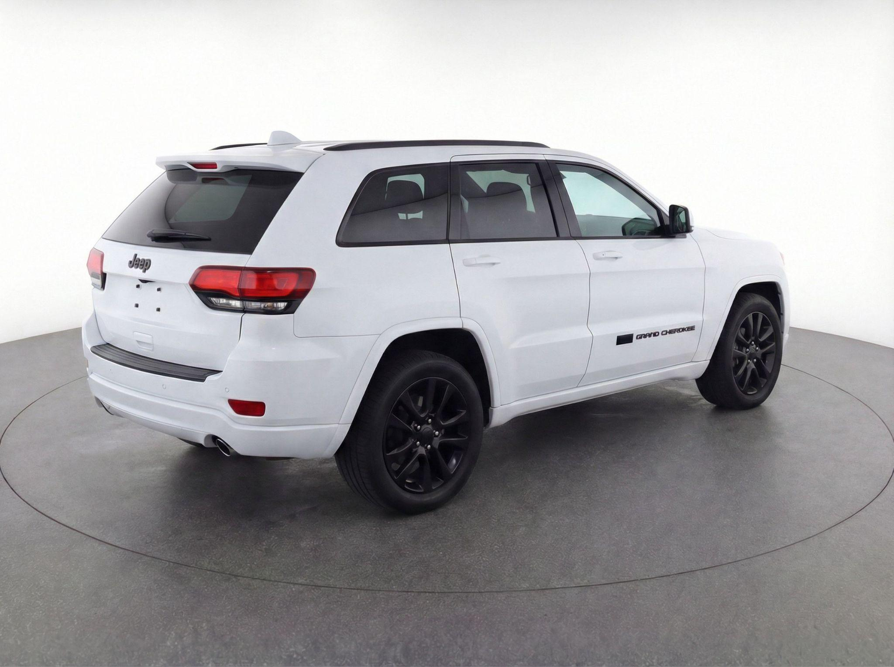
Website Ready Images in One Click
Integrated with:
Notes:
Rob

Slide 20
Actionable Takeaways
Adopt Automated Visual Capture
Defend Your Tire Business
Move beyond handwritten paper multi-point inspections. Provide objective, high-resolution condition reports before the vehicle hits the lift.
Use automated tread diagnostics at the drive-through to quote tires on the spot, backed by dealership warranty programs.
Hold Weekly Accountability Huddles
The RIM Communication Method
Track photo/video send percentages per advisor and technician weekly to ensure consistent execution.
Standardize advisor presentations into Required, Immediate, and Maintenance to remove aggressive sales pressure.
Notes:
Both

Slide 21

Schedule a Demo with UVeye
uveye.com/contact/
Notes:
Both

Slide 22
Thank you for joining today's GNYADA educational webinar!
Gus Karagianis
Rob Hubbell
Service Director
Silver Star Motors
gus@silverstarny.com
VP of Enterprise Sales
UVeye
rob.h@uveye.com
Notes:
Both

