Slide 1

What to Do When ICE Shows Up at
Your Dealership
Thursday, October 2, 2025

Slide 2


Slide 3

GNYADA Dealer Webinars are Sponsored by:
Maggie Drake
Head of National Sales
PREMION
Direct
Mdrake@premion.com

Slide 4
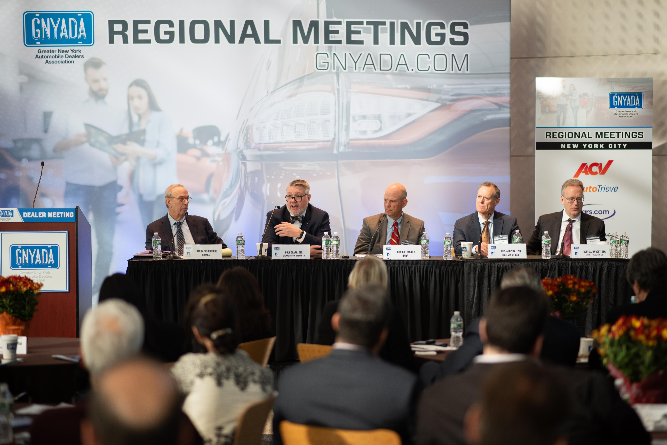


Regional Dealer Breakfast Meetings
New York City
October 7, 2025 | 8:30 am
The Center for Automotive Education & Training
Mid & Lower Hudson Valley
October 8, 2025 | 8:30 am
The Opus Westchester
Long Island
October 9, 2025 | 8:30 am
Melville Marriott
SCAN TO REGISTER!

Slide 5
Facing ICE and DHS at the Dealership: Readiness Strategies for Employers
10/02/2025
Liz Heifetz
Associate
eheifetz@bsk.com
New York, NY

Slide 6
Disclaimer
The materials presented at this presentation are for informational purposes only and not for the purpose of providing legal advice. Contact attorney directly to obtain advice with respect to your specific situation or questions.

Slide 7
Understanding ICE and DHS Enforcement
Types of Government Agent Visits:
Notices of Inspection (NOIs)
Department of Labor: OSHA, immigration-related inspections, audits, I-9 compliance
US Department of Homeland Security – Immigration and Customs Enforcement (ICE), US Citizenship and Immigration Services (USCIS)
I-9 Audits
Requests for Information
Searches of property or people for questioning or detention or arrest

Slide 8
Why dealerships could be vulnerable to inspection?
Common risk factors:
Use of contract labor (detailing, transport, cleaning)
Inadequate HR processes
Misclassified workers
High employee turnover

Slide 9
I-9 Compliance
Advance Preparation For an I-9 Inspection
Conduct internal I-9 audits
Confirm E-Verify Policy
Perform Re-Verification where necessary
Implement annual compliance training for your Human Resources teams
Ensure your team is using the correct version of Form I-9
If ICE finds problems during I-9 audit, you could face:
  Civil fines per violation (can total tens of thousands)
  Criminal charges (for knowingly hiring unauthorized workers)
  Debarment from federal contracts
  Loss of business reputation
  Possible follow-up raids

Slide 10
I-9 Compliance
What can be inspected?
I-9s & supporting documents retained for compliance
Photocopies of I-9 documents stored with I-9s
If stored electronically, associated audit trails that show the actions performed within or on the system during a given period of time
Payroll records, employee lists, corporate documents

Slide 11
Managing employees during I-9 audit
Be transparent about the process, let employees know you are undergoing an audit
Provide employees with reasonable amount of time to correct discrepancies in their records
Treat all employees the same manner during audit
If employees represented by union, inform the union of the audit and determine whether CBA triggers any obligations
Communicate in writing with employees regarding the information you need

Slide 12
During an on-site Enforcement Action: What to Do
  Conduct
  Convey a tone and air of cooperation, not of resistance or obstruction.
  Cooperation will go far, and ICE agents will appreciate it.
  Connect with designated liaison
  Request identification and any legal documentation
    Purpose on-site
    Names of the agents
    ID badges
    Agency affiliation
    Any legal documentations (e.g., subpoena, judicial or administrative warrants).

Slide 13
During an on-site Enforcement Action: What to Do
  Public/Private Area Distinction
  Public Areas: If general public allowed to enter, then fair game for government agents to enter.
    Government agents do not have authority to stop, question or arrest an individual in a public area without probable cause, the individual’s consent or a warrant.
    If ICE presents a valid warrant and has the jurisdiction to conduct an arrest, the designated representative may request that the arrest be moved to a more private location to protect the arrestee’s privacy, particularly if the arrest occurs in a public area.
    Remove any visible documentation that is in plain view

Slide 14
During an on-site Enforcement Action: What to Do
  Non-Public Areas: If general public may not enter, then government agents cannot enter without warrant.
    Where possible, private areas should be designated by signage on or near entrances as to who may enter
    Agents may not enter a private area without a judicial warrant.
    Agents may enter a private area without a judicial warrant or permission if exigent circumstances exist, such as in an emergency, which would include threats to public safety or a threat to someone’s life.
    If agents try to enter a non-public area, you may say: This is a private area. You cannot enter without a judicial warrant signed by a judge.

Slide 15
During an on-site Enforcement Action: What to Do
Subpoenas, Warrants and Requests for Searches and Seizures
Subpoenas: requests to provide documents or appear to testify in court or some other location at a future date.
    Administrative – Does not require compliance
    Judicial – Requires Compliance

Slide 16
During an on-site Enforcement Action: What to Do
  Warrants: used to obtain immediate access to premises and people, usually for activities like arrests, searches, and seizures.
    Administrative Warrant: An administrative warrant does not allow an immigration agent to enter a private area without permission. These are not issued by courts, but by the Department of Homeland Security and are on Forms I-200 or I-205.
    Judicial Warrant : The judicial warrant must say “U.S. District Court” or have a State Court name at the top.

Slide 17
During an on-site Enforcement Action: What to Do
Timing of Responses to Subpoenas and Warrants
What if the agent wants to wait while information is being gathered and attorneys are consulted?
Subpoenas: Inform agent that you will respond by deadline. Note: “Respond” might mean challenging the subpoena in court, not necessarily complying with it.
Warrants: “Please come back later” or “Let’s have some coffee”

Slide 18
Be Prepared! What to Do Now
Compile your I-9 forms, separate from other personnel files.
Instruct your employees
Mark private areas of the business
Create action and implementation plan
Retain an attorney to have at the ready.

Slide 19
Questions?

